Slide 1
Python for Data Science:
ML Introduction
Presented by: Hussein El Amouri
Prepared by: Mathilda Khalil

Slide 2
Machine Learning Bootcamp

Slide 3
AI, Machine Learning & Deep Learning
Artificial intelligence
Machines that mimic human intelligence.
Machine learning
Learn patterns from data to make predictions.
Deep learning
Neural networks that handle complex data

Slide 4
Machine Learning Infographics
01
02
Supervised Learning
Unsupervised Learning
Learn from labeled data (inputs + outputs).
Find hidden patterns in unlabeled data.
Machine learning
03
Reinforcement Learning
Learn by interacting with the environment and receiving feedback.

Slide 5
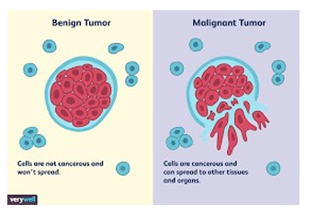
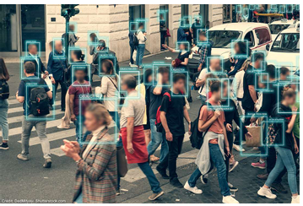
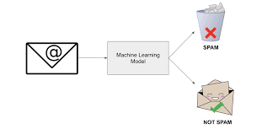
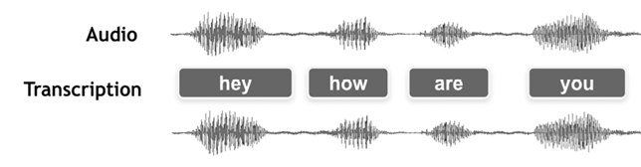
Applications of ML
Medical field: Analysis of the shape and color of cells to detect cancer
Computer vision: Face detection, automatic language translation, speech recognition.

Slide 6
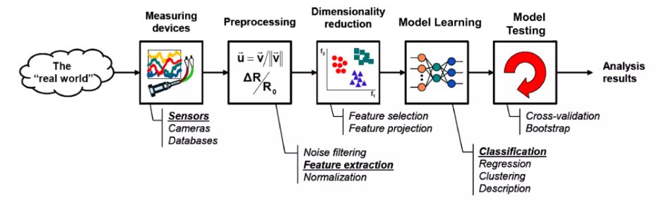
Learning Process

Slide 7
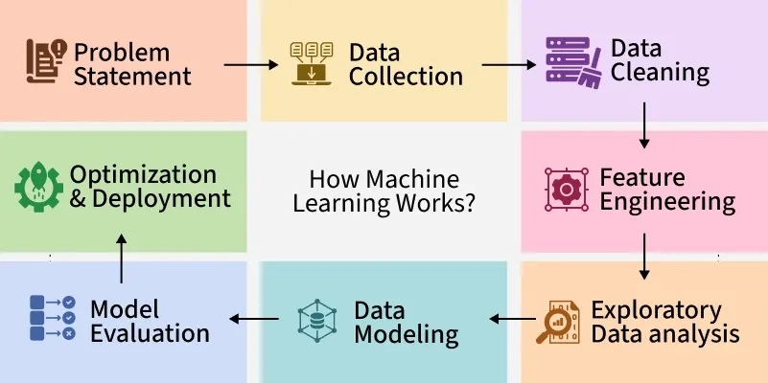
Machine Learning Workflow
Collect Data
Preprocess Data
Split into Train/Test sets
Train Model
Evaluate & Improve
Deploy & Use Predictions

Slide 8
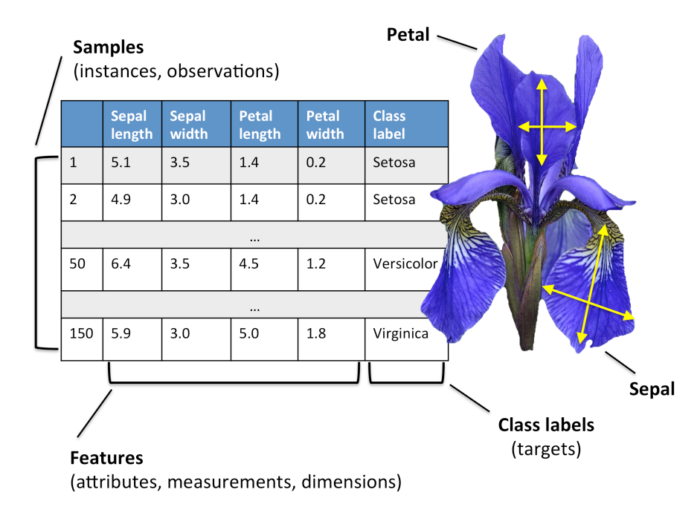

Step 1: Collect Data
In the Iris dataset: 150 samples, 4 features (sepal length, sepal width, petal length, petal width).
3 flower species (target): Setosa, Versicolor, Virginica.

Slide 9
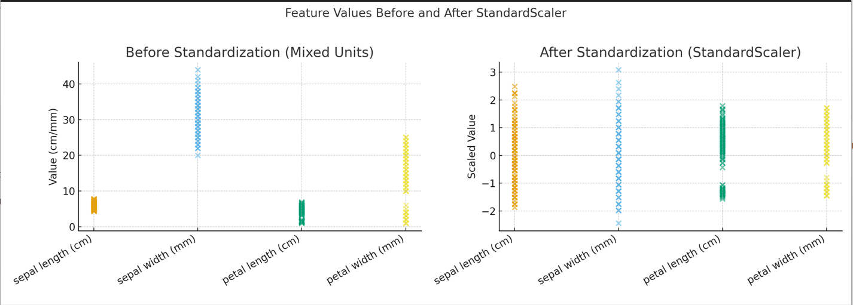

Step 2: Preprocess Data
Ensure data is clean: no missing values, duplicates.
Normalize features: petal length (cm) vs sepal width (mm) → scale them for fairness.
Why? Some ML algorithms are sensitive to scale (e.g., k-NN, SVM).
Iris dataset features are often standardized.

Slide 10
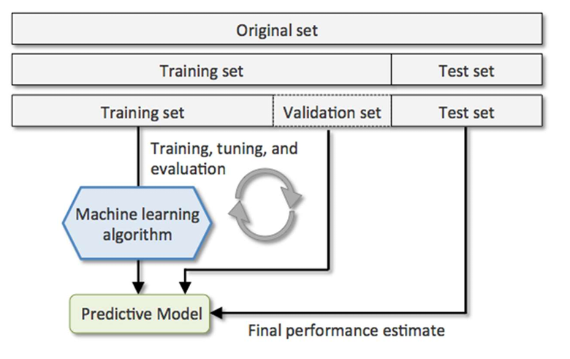
Step 3: Split Data
We split into Training and Testing sets to evaluate performance.
Training set → model learns patterns.
Testing set → evaluate generalization on unseen data.
Validation set → tune hyperparameters, prevent overfitting.
Example: 120 samples for training, 30 samples for testing.

Slide 11
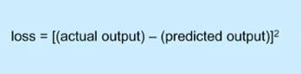
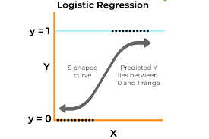
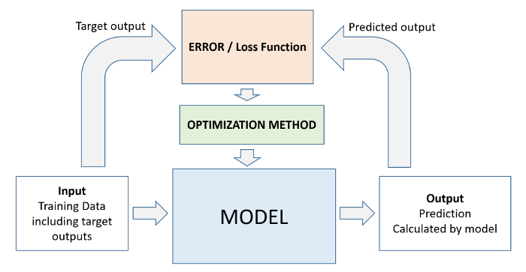
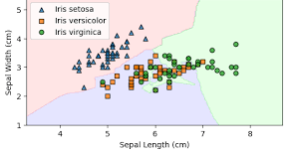
Step 4: Train the Model
The model learns relationships between inputs and outputs.
Uses an optimization algorithm (Gradient Descent) to adjust parameters.
Loss Function: measures how far predictions are from actual labels
In Iris: features (petal & sepal sizes) → predict species label.
Example: Train a Logistic regression to separate Setosa vs others.

Slide 12
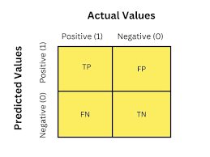
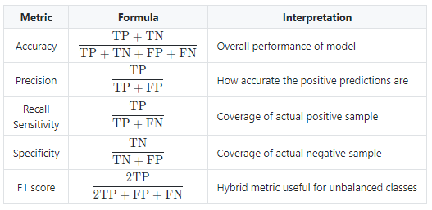
Step 5: Evaluate the Model
Use metrics to measure performance.
Accuracy = % of correct predictions.
Confusion Matrix shows detailed prediction results per class.

Slide 13
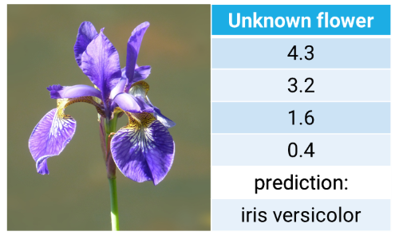
Step 6: Make Predictions
After training, we can predict on new flower samples.
Input: Petal length=5.0, Petal width=1.8 → Model predicts Versicolor.
This is the final output of the ML pipeline.
Model outputs probabilities:
Setosa = 3%
Versicolor = 82%
Virginica = 15%
Features
Target

